Slide 1

Insurance Cost Prediction Group No: 29
Multiple Linear Regression
Random Forest Regression
MLR with PCA
RFR with PCA
Shreya Naik
Shubham Chavan
Vasundhara Chilakala
Jayesh Raikwar

Slide 2
Problem Statement
The main aim is to find the medical insurance amount of the individual using the different factors like Age, Gender, BMI, Region, Smoking habits, etc.
We have used following three model to find out the medical insurance cost.
Multiple Linear Regression
Random Forest Regression
Multiple Linear Regression using Principal Component Analysis
Random Forest Regression using Principal Component Analysis

Slide 3
Multiple Linear Regression

Slide 4
Multiple Linear Regression
Multiple linear regression can be defined as extended simple linear regression
It comes under usage when we want to predict a single output depending upon multiple input or we can say that the predicted value of a variable is based upon the value of two or more different variables.
The predicted variable or the variable we want to predict is called the dependent variable (or sometimes, the outcome, target or criterion variable) and the variables being used in prediction of the value of the dependent variable are called the independent variables (or sometimes, the predict, explanatory or regressor variables)

Slide 5
Work Flow
In First step we have done the Data Analysis.
In Second step we have pre processed the data in suitable manner for the model preparation.
In Third step we have created the linear regression model
And at Last we builded the predictive system which predicts the insurance cost after reading the input data.
Data Analysis
Data Pre Processing
Linear Regression model

Slide 6
Dataset Table
The data set includes seven attributes.
Name | Description
Age | Age of the client
BMI | Body Mass Index
Children | Number of children the client have
Gender | Male / Female
Smoker | Whether a client is smoker or not
Region | Where the client lives southwest, southeast, northwest, northeast.
Charges (target variable) | Insurance cost for the client to pay

Slide 7
Data Pre -processing
Data preprocessing is a technique which is used to transform the raw data in a useful and efficient format.
In this model data is pre processed and is converted into a suitable format by checking whether there is any null value or not.
In this data set we found that there is no any null value
Also the categorical variables are translated into numeric or binary values to represent either 0 or 1 as shown in table.

Slide 8
Data Encoding
GENDER
SMOKER
Male | 0
Female | 1
YES | 0
NO | 1
REGION
SOUTHEAST | 0
SOUTHWEST | 1
NORTHEAST | 2
NORTHWEST | 3

Slide 9
Splitting the data
After the data encoding, data is splited into features and target
The Charges is set as a target in Y variable and the rest of all are set into X variable on which the insurance cost will be predicted by using algorithm
Also further the Data is splitted into training data and testing data. In which the 80% of data is training data used to predict the insurance and the 20% of the data is testing data.

Slide 10
Prediction on training data and testing data
After splitting the data in training and testing , the data loaded the linear regression model as regressor = LinearRegression() and fitted the training data into it.
After that the predictions are made on training data and testing data
And in the final step the performance evaluation of the algorithm is done using the evaluation metrics R-squared value and MSE value for the both training data and testing data.

Slide 11
The Predictive System
At last, we have builded the predictive system.
This system takes the details of customer like Age, BMI, Gender, Region, etc as an input and based on the previous Dataset it Predicts the suitable amount of insurance for that person.

Slide 12
Random Forest Regression

Slide 13
Random Forest Regression
Random Forest Regression is a supervised learning algorithm that uses ensemble learning method for regression.
Ensemble learning method is a technique that combines predictions from multiple machine learning algorithms to make a more accurate prediction than a single model.
A Random Forest Regression model is powerful and accurate. It usually performs great on many problems, including features with non-linear relationships.

Slide 14
Dataset Used
The data set includes seven attributes.
Name | Description
Age | Age of the client
BMI | Body Mass Index
Children | Number of children the client have
Gender | Male / Female
Smoker | Whether a client is smoker or not
Region | Where the client lives southwest, southeast, northwest, northeast.
Charges (target variable) | Insurance cost for the client to pay

Slide 15
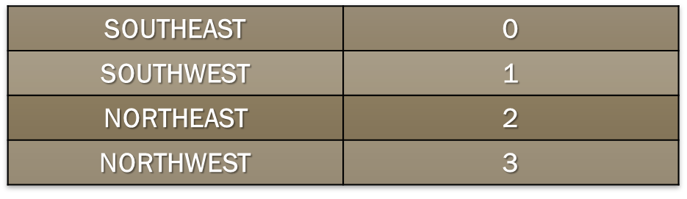
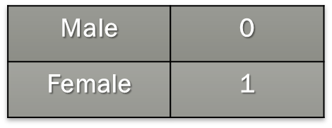
Data Pre-processing
In Data Pre-processing, the data is converted into a suitable format by checking whether there is any null value or not.
In given dataset some of values are in categorical term, which is not suitable so these values are converted into numerical values like following,
Region
Gender
Smoker
YES | 0
NO | 1

Slide 16
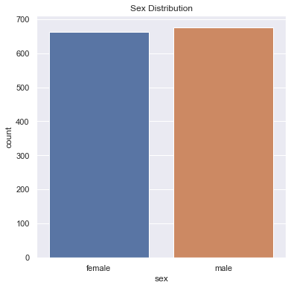
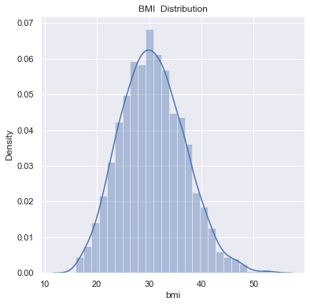
Data Visualization
Following are the some of graphs of given dataset

Slide 17
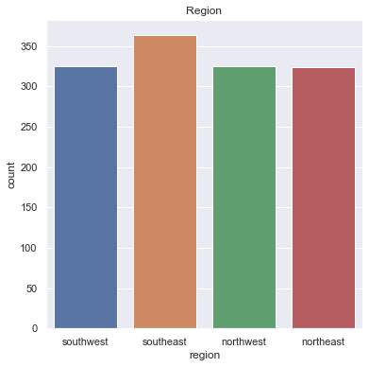
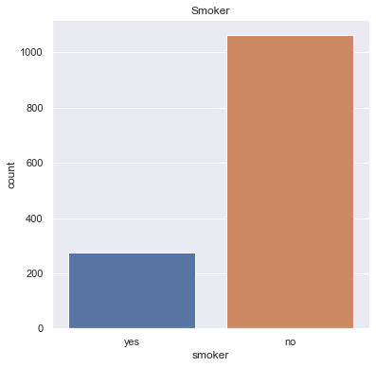

Slide 18
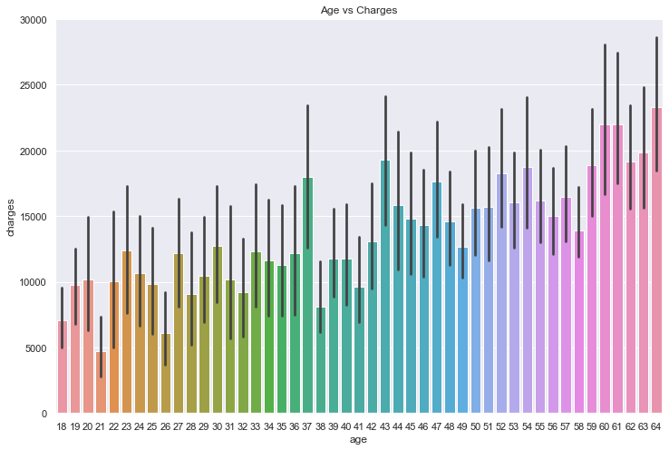

Slide 19
Prediction on Model
The dataset given is splitted into training and testing data.
In total data, 80% data is used in training data and remaining 20% data is used for testing data.
The model is trained using the data to analyze the data and then tested the performance of model.
At last user can add their details like age, gender, BMI, No of children, smoking habits, etc. to predict their own insurance cost.
The R2 and RMSE is calculated to determine the accuracy of the model.

Slide 20
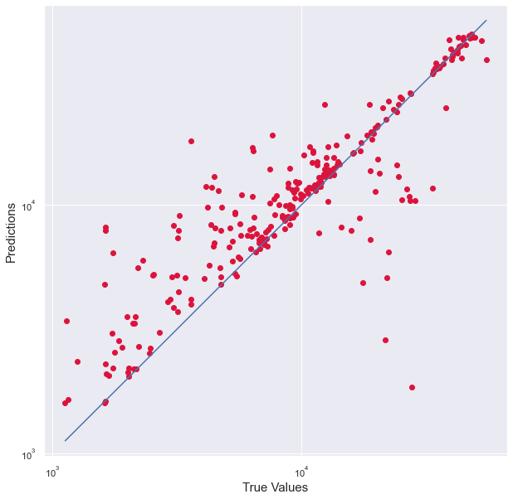
Graph of Predicted and True Values

Slide 21
Multiple Linear Regression using Principal Component Analysis

Slide 22
Principal Component Analysis
Principal Component Analysis, or PCA, is a dimensionality-reduction method that is often used to reduce the dimensionality of large data sets, by transforming a large set of variables into a smaller one that still contains most of the information in the large set.
It is a statistical procedure that uses an orthogonal transformation that converts a set of correlated variables to a set of uncorrelated variables.
PCA is the most widely used tool in exploratory data analysis and in machine learning for predictive models. Moreover, PCA is an unsupervised statistical technique used to examine the interrelations among a set of variables.
It is also known as a general factor analysis where regression determines a line of best fit.

Slide 23
Dataset Used
The data set includes seven attributes.
Name | Description
Age | Age of the client
BMI | Body Mass Index
Children | Number of children the client have
Gender | Male / Female
Smoker | Whether a client is smoker or not
Region | Where the client lives southwest, southeast, northwest, northeast.
Charges (target variable) | Insurance cost for the client to pay

Slide 24
Prediction on Model
The dataset given is splitted into training and testing data.
In total data, 80% data is used in training data and remaining 20% data is used for testing data.
The training and testing data is transformed using Principal Components analysis and then evaluated using Linear regression model.
The R2 and RMSE is calculated to determine the accuracy of the model.

Slide 25
Random Forest Regression using Principal Component Analysis

Slide 26
Principal Component Analysis
Principal Component Analysis, or PCA, is a dimensionality-reduction method that is often used to reduce the dimensionality of large data sets, by transforming a large set of variables into a smaller one that still contains most of the information in the large set.
It is a statistical procedure that uses an orthogonal transformation that converts a set of correlated variables to a set of uncorrelated variables.
PCA is the most widely used tool in exploratory data analysis and in machine learning for predictive models. Moreover, PCA is an unsupervised statistical technique used to examine the interrelations among a set of variables.
It is also known as a general factor analysis where regression determines a line of best fit.

Slide 27
Dataset Used
The data set includes seven attributes.
Name | Description
Age | Age of the client
BMI | Body Mass Index
Children | Number of children the client have
Gender | Male / Female
Smoker | Whether a client is smoker or not
Region | Where the client lives southwest, southeast, northwest, northeast.
Charges (target variable) | Insurance cost for the client to pay

Slide 28
Prediction on Model
The dataset given is splitted into training and testing data.
In total data, 80% data is used in training data and remaining 20% data is used for testing data.
The training and testing data is transformed using Principal Components analysis and then evaluated using Linear regression model.
The R2 and RMSE is calculated to determine the accuracy of the model.

Slide 29
Conclusion
From these three models we observed that there is difference in accuracy
Among the three models Random Forest Regression model have the highest accuracy of 85%.
Following table shows the R2 and MSE values of all models
From this we can say that the Random Forest Regression Model is more accurate than other two because decision Tree is better than Linear Regression, since Trees can accurately divide the data based on Categorical Variables.
 | MLR | RFR | MLR with PCA | RFR with PCA
R2 | 0.79 | 0.85 | 0.93 | 0.13
MSE | 5641.62 | 4860.46 | 3108.12 | 106.78

